Slide 1
REKRUIT
Human Resource Managament Software
by Ridesh Raj & Hemapriya
Demo link – https://drive.google.com/file/d/1yG_BJsvvKezg9zYHfeAjXvJR0LJAVT9l/view?usp=sharing

Slide 2

About the System
Human Resource Management System can be defined as, employing people, developing their resource, utilize maintaining and compensating their services in tune with the job and organizational requirements.

Slide 3

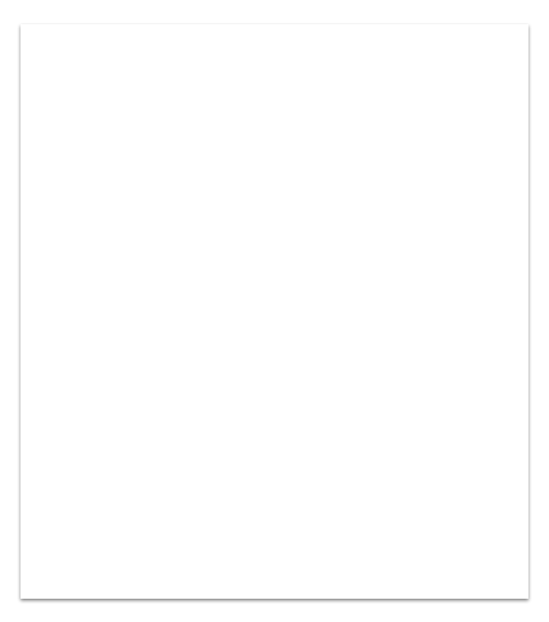
1. Tech Stack
The HRM System we developed, consists of 3
Front End HTML, CSS, JS, Thymeleaf, Bootstrap.
Data Java Persistence API (JPA), SQL.
Backend Java, Spring Boot.

Slide 4
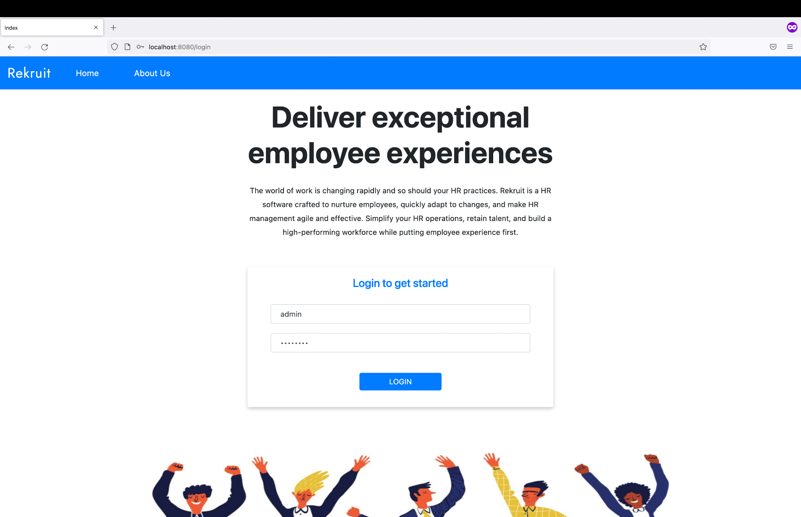
Login
A Login access is given to 2 entities. They are User and Admin.
Spring boot Security has been used, that will take care of authentication and access to the Software.

Slide 5

Search
2 types of Searches are implemented,
General Search, which is used to search all the applications of the candidates with respect to multiple search criterias.
Specific Search, which is used to search the applications of the candidates with respect to single search query.

Slide 6

Mailing
With Attachment, The Candidate will receive an email with a content and also attached with Offer Letter(PDF).
Without Attachment, The Candidate will receive an email with a only with content body.
The Dependencies used are itextpdf and pdfbox.

Slide 7

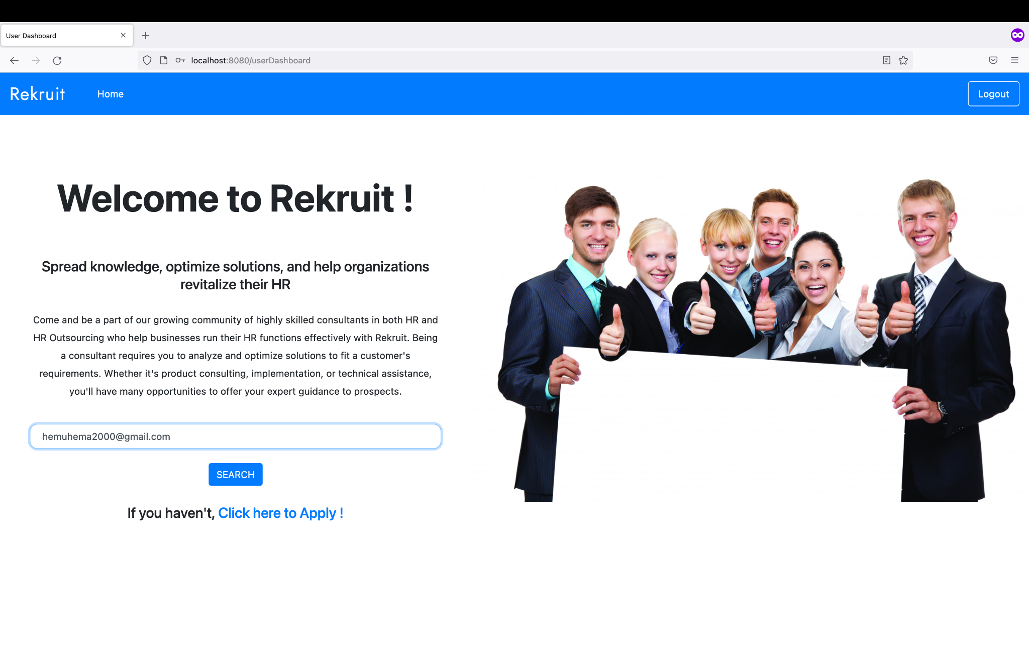

User dashboard
The Candidate can able to view their details in the Dashboard.
Not only they can view, They can able to edit, delete, and also register a new application.
They can also view all their previous applications by searching through their mail.
Tip
If one example isn’t sufficient to help people understand the breadth of your idea, pick a couple of examples.

Slide 8
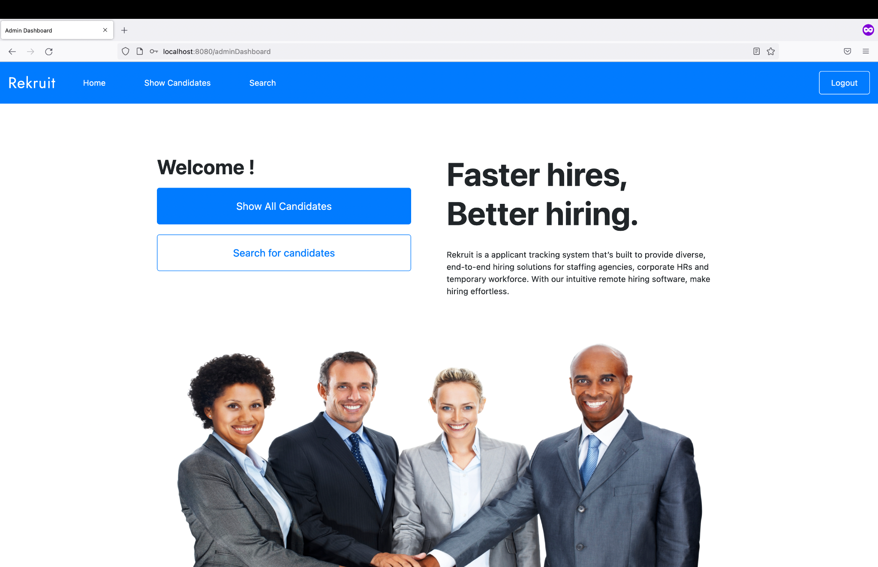
Admin Dashboard
The Admin can able to search and filter the candidates with respect to their requirements.
The Admin is provided with both General and Specific Search.
They can also view, delete the candidate’s application and also send mail with and without attachment.

Slide 9
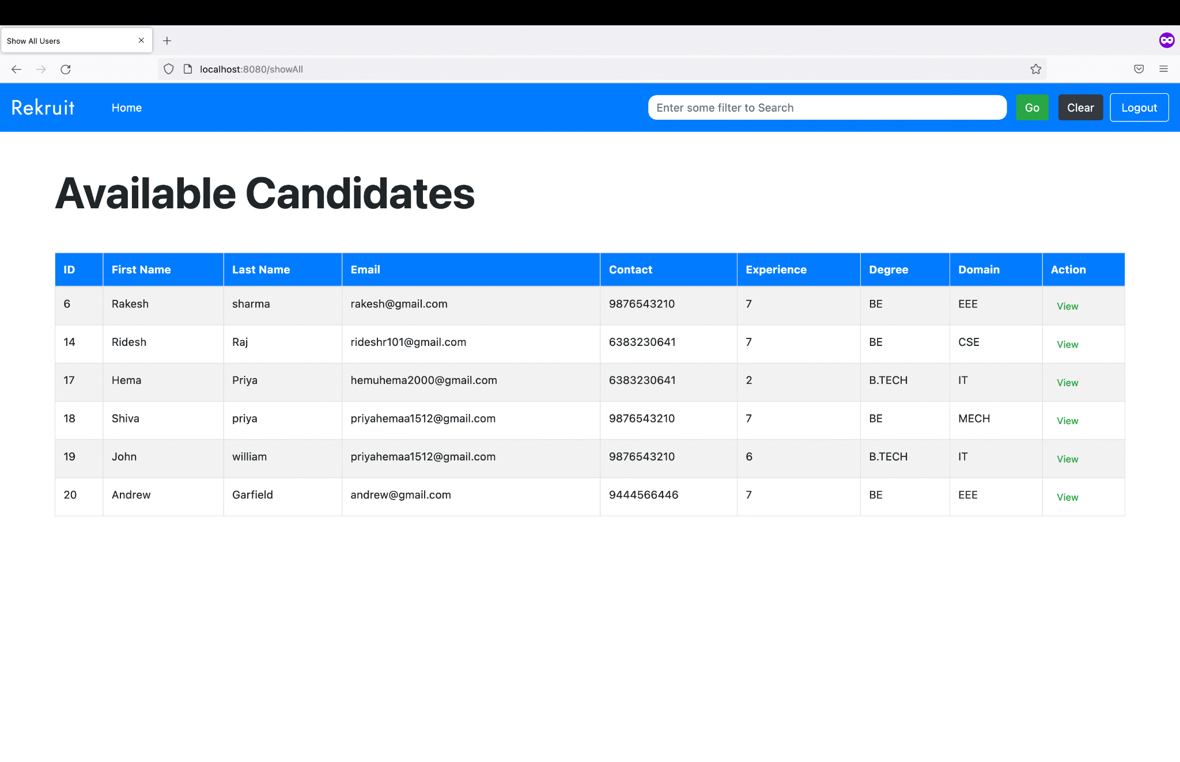
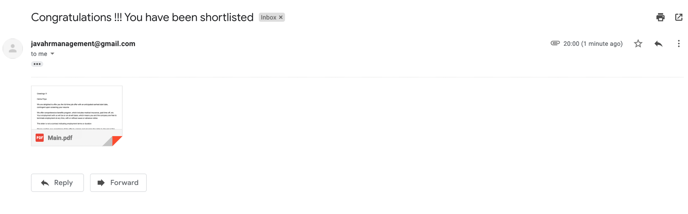
Snapshots

Slide 10
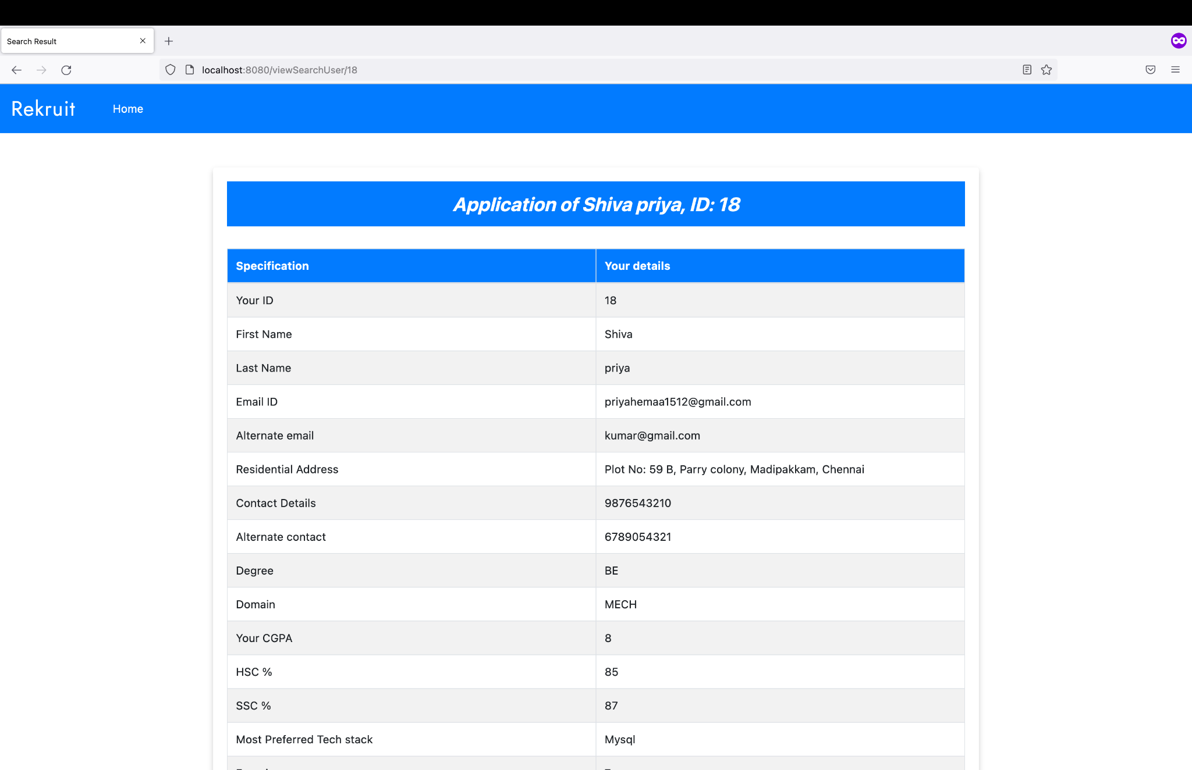
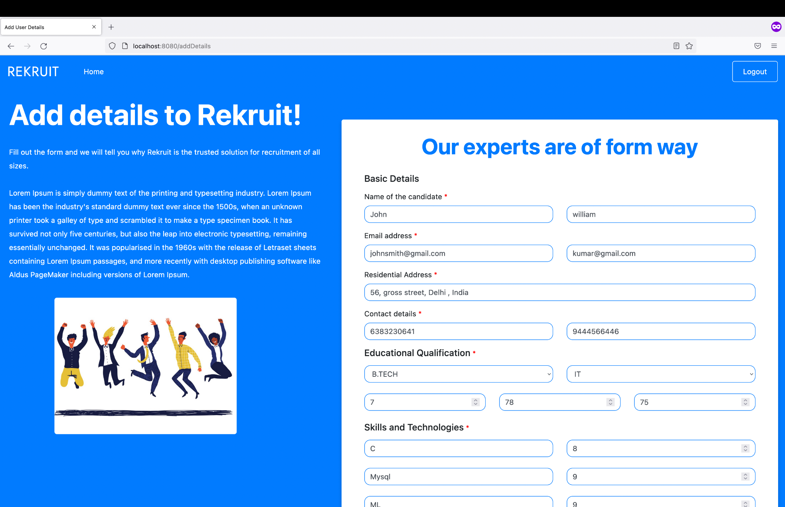
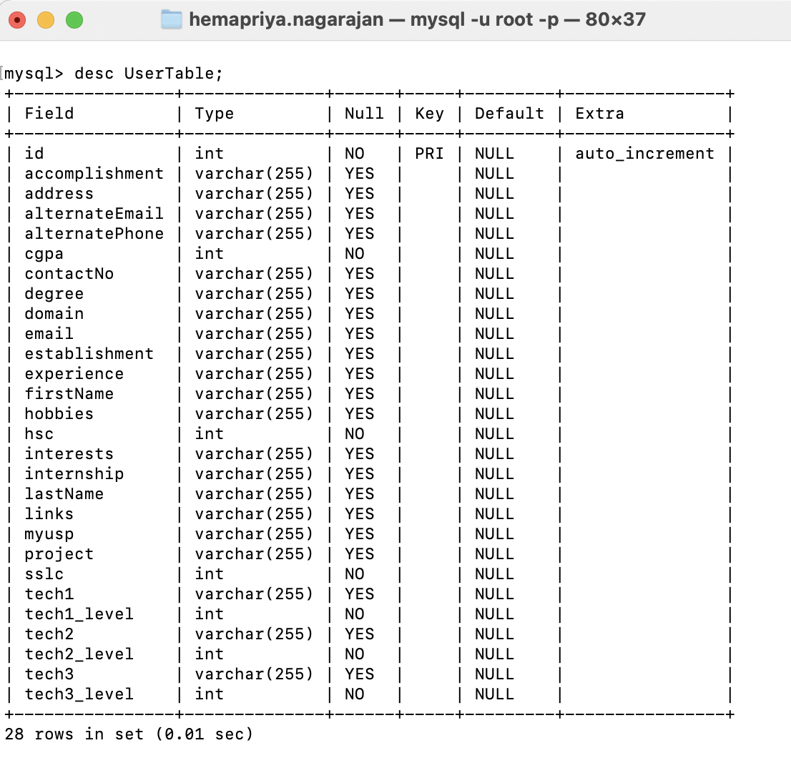
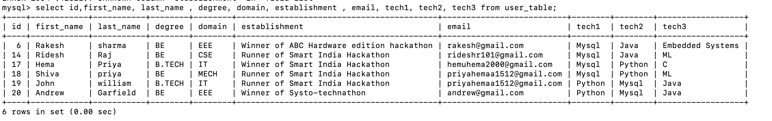

Slide 11

THANK YOU!!

